Slide 1

ITP 259: Basics of Artificial Intelligence Fall 2024 Lecture 10: Recap Regression vs Classification, MLPRegressor
Dr. Martin Prescher
Viterbi school of engineering

Slide 2

“Artificial intelligence would be the ultimate version of Google. The ultimate search engine that would understand everything on the web. It would understand exactly what you wanted, and it would give you the right thing. We’re nowhere near doing that now. However, we can get incrementally closer to that, and that is basically what we work on.”
- Larry Page

Slide 3
Outline / Announcements
No Homework this week, we will focus on Recap and extension what we have learned; Homework 5 due on Oct 8
General Recap Classification vs. Regression
New Data Set – California Housing Data
Pre-Processing, understanding the data
Comparison of
Linear Regression
Polynomial Regression
MLPRegressor (Neural Network)

Slide 4



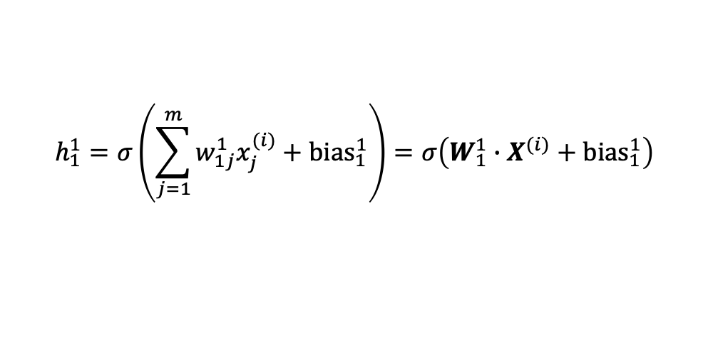







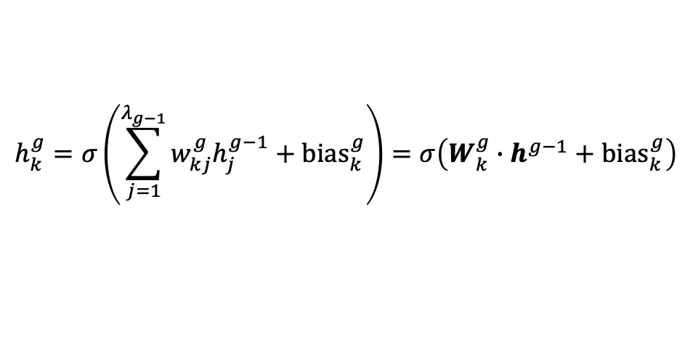





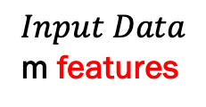




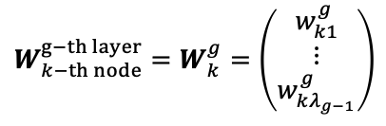
Recap on NN for Classification
We have extensively studied Neural Networks for Classification problems. Recap from Lecture 7:
$$W_{1}^{1}=\left(\begin{aligned}w_{11}^{1} \\ ⋮ \\ w_{1m}^{1}\end{aligned}\right)$$
$${W_{k−th node}^{g−th layer}=W}_{k}^{g}=\left(\begin{aligned}w_{k1}^{g} \\ ⋮ \\ w_{kλ_{g−1}}^{g}\end{aligned}\right)$$
…
Weight vectors:
$$x_{1}^{(i)}$$
$$W_{1}^{1}$$
$$h_{1}^{1}$$
$$h_{1}^{P}$$
Node outputs:
$$x_{2}^{(i)}$$
$$h_{1}^{1}=σ\left(\sum_{j=1}^{m}{w_{1j}^{1}x_{j}^{(i)}}+{bias}_{1}^{1}\right)=σ\left(W_{1}^{1}∙X^{(i)}+{bias}_{1}^{1}\right)$$
$Input Data$ m features
$$W_{2}^{1}$$
$$h_{2}^{1}$$
$$\hat{y}$$
$$W^{out}$$
$$⋮$$
…
…
…
arbitrary node in the network
$$x_{m}^{(i)}$$
$$W_{λ_{1}}^{1}$$
$$h_{λ_{1}}^{1}$$
$$h_{λ_{P}}^{P}$$
$$h_{k}^{g}=σ\left(\sum_{j=1}^{λ_{g−1}}{w_{kj}^{g}h_{j}^{g−1}}+{bias}_{k}^{g}\right)=σ\left(W_{k}^{g}∙h^{g−1}+{bias}_{k}^{g}\right)$$
$$1st hidden layer$$
$with λ_{1} nodes$
$$output$$
$$layer$$
P$−th hidden layer$
$with λ_{P} nodes$
$${generally h}^{g}=\left(\begin{aligned}h_{1}^{g} \\ ⋮ \\ h_{λ_{g}}^{g}\end{aligned}\right)$$
$$\hat{y}=σ\left(W^{out}∙h^{P}+{bias}^{out}\right)$$
P$hidden layers$

Slide 5
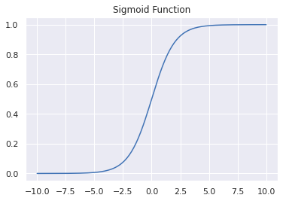







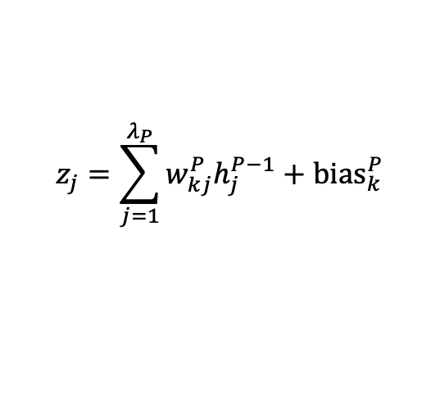














Activation Functions for Multi-Class Classification
In Classification problems, the NN outputs the probabilities that the inputs belong to one of the target classes. Recap from Lecture 7:
Non-Linear Outer Activation Function
$$x_{1}^{(i)}$$
$$h_{1}^{1}$$
…
$$h_{1}^{P}$$
We transformed this output into a true probability by replacing the output layer sigmoid function with the Softmax function.
$$z_{1}^{(i)}$$
$$σ\left(z_{1}\right)$$
$${\hat{y}}_{1}^{(i)}$$
Probability for class 1
0.65
$$x_{2}^{(i)}$$
$$h_{2}^{1}$$
$$z_{2}^{(i)}$$
$$σ\left(z_{2}\right)$$
$${\hat{y}}_{2}^{(i)}$$
0.32
Probability for class 2
$$⋮$$
…
…
…
$$σ\left(z_{3}\right)$$
$${\hat{y}}_{3}^{(i)}$$
Probability for class 3
$$x_{m}^{(i)}$$
$$h_{λ_{1}}^{1}$$
$$h_{λ_{P}}^{P}$$
$$z_{3}^{(i)}$$
0.56
$$input layer$$
$$hidden layer$$
$$output layer$$
$$z_{j}=\sum_{j=1}^{λ_{P}}{w_{kj}^{P}h_{j}^{P−1}}+{bias}_{k}^{P}$$
Non-linear Inner Activation Function(s)
Raw outputs

Slide 6
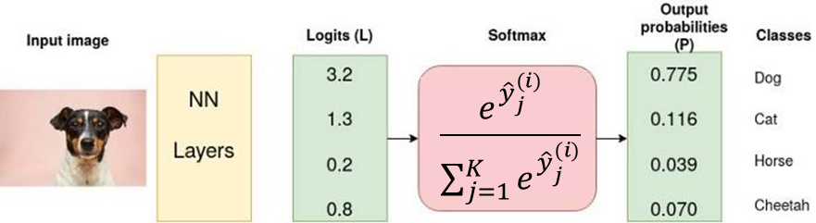
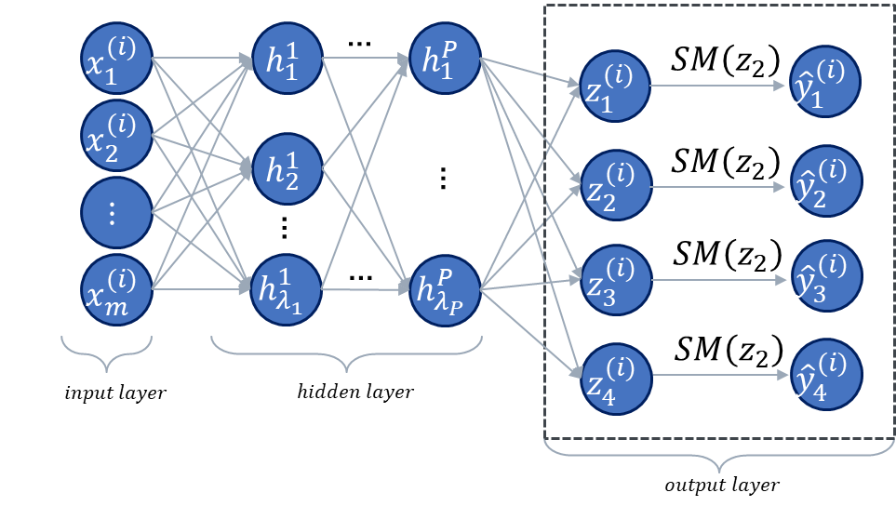
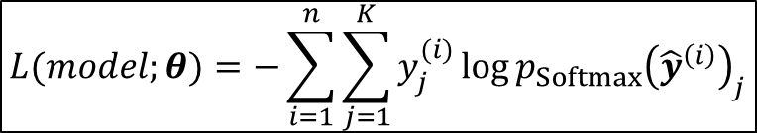

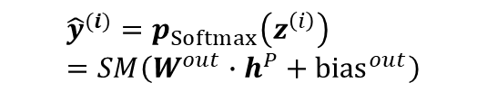

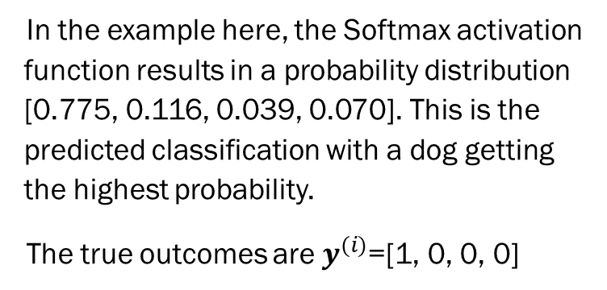
Summary of multiclass Neural Network Loss
$$z^{\left(i\right)}$$
$$K$$
In the example here, the Softmax activation function results in a probability distribution [0.775, 0.116, 0.039, 0.070]. This is the predicted classification with a dog getting the highest probability.
The true outcomes are $y^{(i)}$=[1, 0, 0, 0]
$$x^{\left(i\right)}$$
$$\frac{e^{z_{t}^{(i)}}}{\sum_{j=1}^{K}{e^{z_{j}^{(i)}}}}$$
$${\hat{y}}^{(i)}=p_{Softmax}\left(z^{\left(i\right)}\right)=SM\left(W^{out}∙h^{P}+{bias}^{out}\right)$$
$$L(model;θ)=−\sum_{i=1}^{n}{\sum_{j=1}^{K}{y_{j}^{(i)}\log{{p_{Softmax}\left({\hat{y}}^{\left(i\right)}\right)}_{j}}}}$$
We iterate on the network parameters to minimize the CE loss. (using gradient descent and backprop)
$L=−(1×\log{0.775}+0×$ $\log{0.116+0×\log{0.039}+0×\log{0.07}}=0.255$

Slide 7






















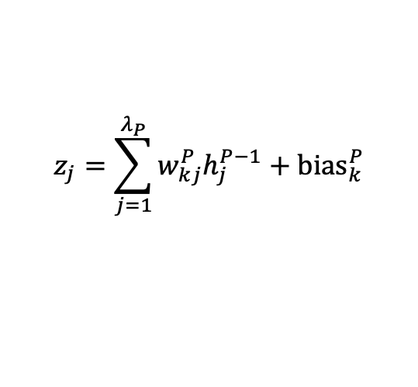
Using Neural Networks for Regression Problems
Neural Networks can be used for Regression problems the same way as for Classification problems. The only big differences are the Activation function in the output, and the loss function:
$$x_{1}^{(i)}$$
$$h_{1}^{1}$$
…
$$h_{1}^{P}$$
$$z_{1}^{(i)}$$
$$σ\left(z_{1}\right)$$
$${\hat{y}}_{1}^{(i)}$$
Target variable 1 (unbounded real value)
1054
The output Activation function becomes a linear function of the raw outputs of the final hidden layer nodes, and usually we just use the Identity function.
$$x_{2}^{(i)}$$
$$h_{2}^{1}$$
$$z_{2}^{(i)}$$
$$σ\left(z_{2}\right)$$
$${\hat{y}}_{2}^{(i)}$$
0.32
Target variable 2 (unbounded real value)
$$⋮$$
…
…
…
$$σ\left(z_{3}\right)$$
$${\hat{y}}_{3}^{(i)}$$
Target variable 3 (unbounded real value)
$$x_{m}^{(i)}$$
$$h_{λ_{1}}^{1}$$
$$h_{λ_{P}}^{P}$$
$$z_{3}^{(i)}$$
-23
$$input layer$$
$$hidden layer$$
$$output layer$$
Still non-linear Inner Activation Function(s)!
$$z_{j}=\sum_{j=1}^{λ_{P}}{w_{kj}^{P}h_{j}^{P−1}}+{bias}_{k}^{P}$$
Raw outputs
${\hat{y}}^{(i)}=Lin({\hat{z}}^{\left(i\right)})$= ${\hat{z}}^{\left(i\right)}$

Slide 8
Overview Outer Activation for Regression vs. Classification problems
Problem Type
Classification
Binary Classification
Multiclass Classification
Regression
Sigmoid/Logistic Activation
Softmax Activation
Identity
Multilabel Classification
Sigmoid/Logistic Activation
Note:
Multilabel Classification is a generalization of the Multiclass Classification in which the output class is non-exclusive, i.e. the output can belong to multiple classes; it requires a Sigmoid-shaped function as the output activation function (see explanation of softmax)
Output Activation Function to be used

Slide 9
Overview NN for Regression vs. Classification problems
 | Classification | Regression
Target | Discrete (dependent) target variables (classes) | (Dependent) Target variables continuous
Input | Independent numerical or categorical variables | Independent numerical variables
Output | Probability of a sample belonging to a class, bounded in [0,1], sum of all output probabilities = 1 | Numerical value, unbounded
Problem types | Any type of classification problem, such as disease prediction (sick yes/no), image classification, handwriting recognition, spam emails, etc | Any type of prediction of real numbers (price prediction, rainfall, stock market, sales forecasting, etc.)
Model types | Logistic Regression K-Nearest Neighbours Neural Networks | Linear regression, multiple linear regression Non-linear regression (e.g. polynomial, Neural Networks), Support Vector Regression, Decision Tree Regression, Random Forest Regression
Model Fit Algorithm | Find the best possible decision boundary (a hyperplane) that separates classes; separate the data into regions in the input space with maximal probability of data points belonging to a respective class | Find the best fit line (or hyperplane) to predict the (numerical) outcome based on input data
Loss Function / Evaluation Metrics | Cross-Entropy (multi-class) Negative Log-Likelihood (binary classification) | Mean Square Error, Mean Absolute Error, R2-Score, MAPE
Scitkit-Learn Packages introduced so far | LogisticRegression DecisionTreeClassifier KNeighborsClassifier MLPClassifier | LinearRegression MLPRegressor Linear Regression with polynomial features
Support Vector Machines
Naïve Bayes
Decision Tree Classification

Slide 10
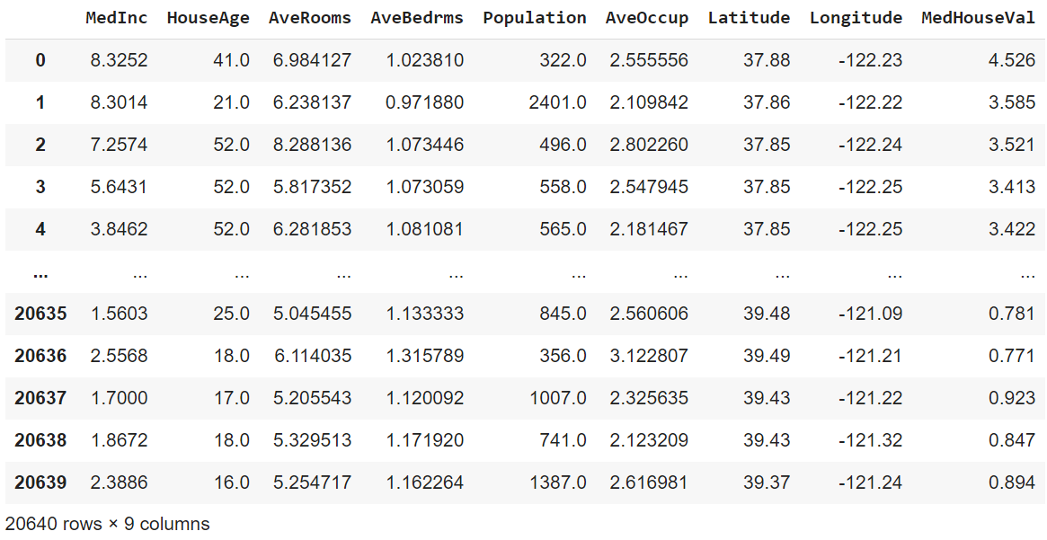
California Housing Dataset

Slide 11

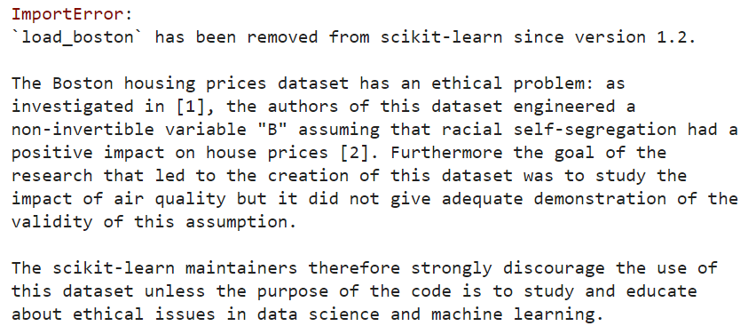
DANGER! Boston Housing Dataset

Slide 12
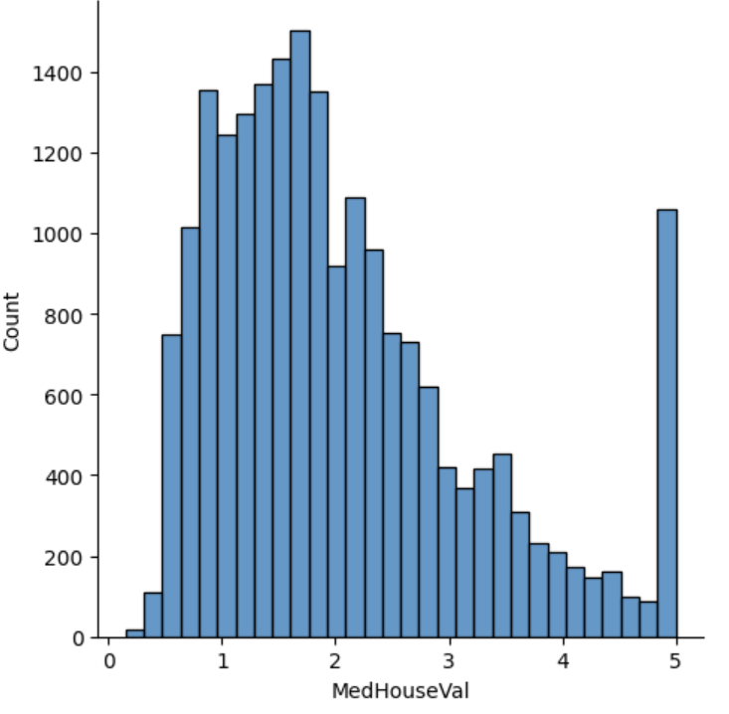
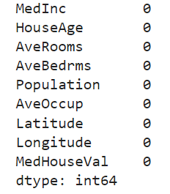
Step 1: Data Exploration
Histogram for target variable
Number of zeros

Slide 13
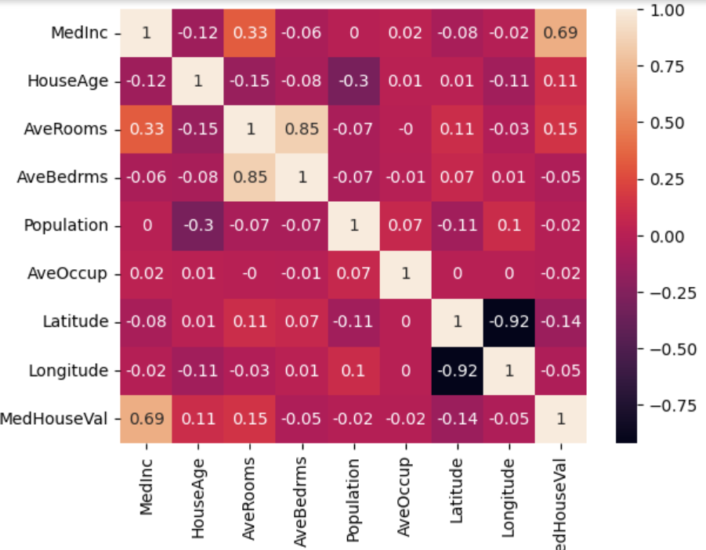
Step 1: Data Exploration
Correlation Matrix
Shows the correlation coefficients of each variable pair
Correlation coefficient is the covariance divided by the standard deviations (for normalization)
Covariance is a measure of the strength of a linear relationship between two variables. Its values can range from -1 to 1.

Slide 14
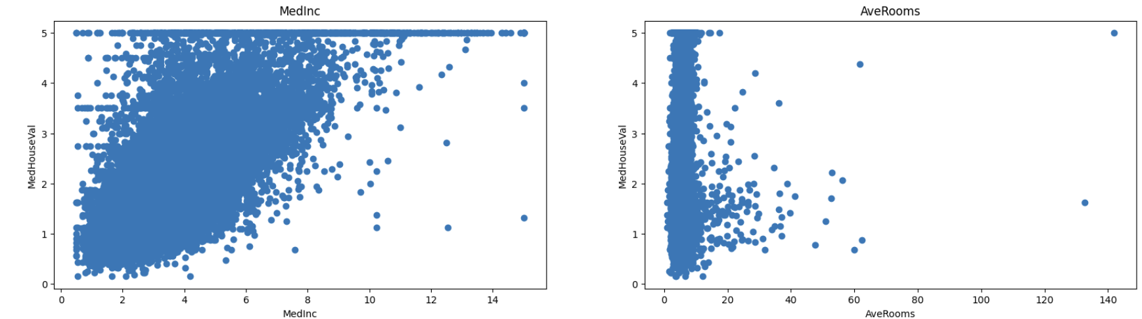
Step 1: Data Exploration

Slide 15

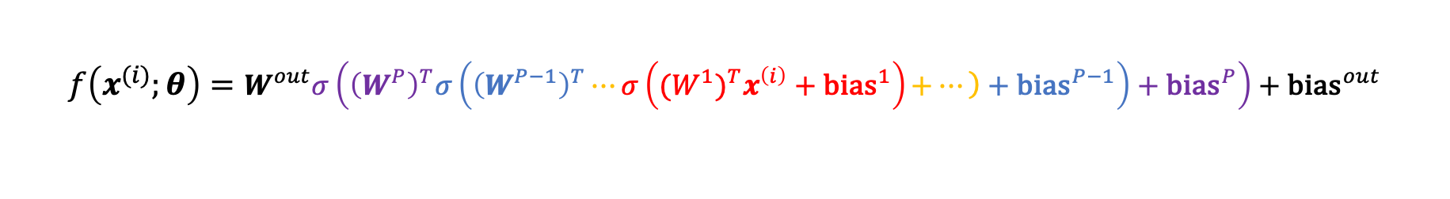
Problem Statement
Predict the Median Value medv using 3 models:
Model 1: Fit a Linear Model
Model 2: Fit a Polynomial Model (more explanation later)
Model 3: Fit a multi-layer Neural Network
Note: we used the identity function as the final activation function as noted earlier
$$f\left(x^{(i)};θ\right)=θ_{0}+θ_{1}x_{1}^{(i)}+…+θ_{m}x_{m}^{(i)}$$
$$f\left(x^{(i)};θ\right)=θ_{0}+θ_{1}{\left(x_{1}^{2}\right)}^{(i)}+…+θ_{m}{\left(x_{m}^{m}\right)}^{(i)}$$
$$f\left(x^{(i)};θ\right)=W^{out}σ\left({\left(W^{P}\right)}^{T}σ\left({\left(W^{P−1}\right)}^{T}⋯σ\left({(W^{1})}^{T}x^{\left(i\right)}+{\text{bias}}^{1}\right)\left.+…\right)+{\text{bias}}^{P−1}\right)+{\text{bias}}^{P}\right)+{\text{bias}}^{out}$$

Slide 16
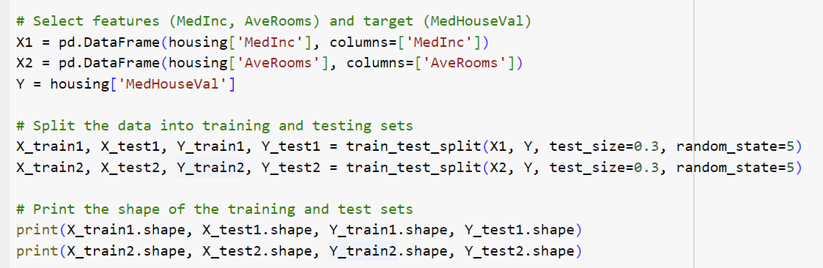
Step 2: Pre-Processing

Slide 17
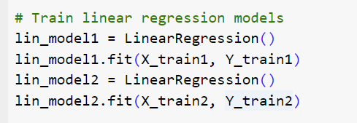
Step 3: Training the Linear Model
Model 1: Linear Regression

Slide 18
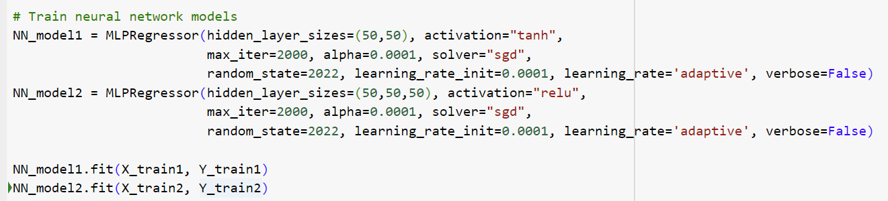
Step 3: Training the NN Model
Model 2: Neural Network Regressor
Note: we are for now training two separate networks for the variable pairs
(MedInc, MedHouseVal) and (AveRooms, MedHouseVal)

Slide 19
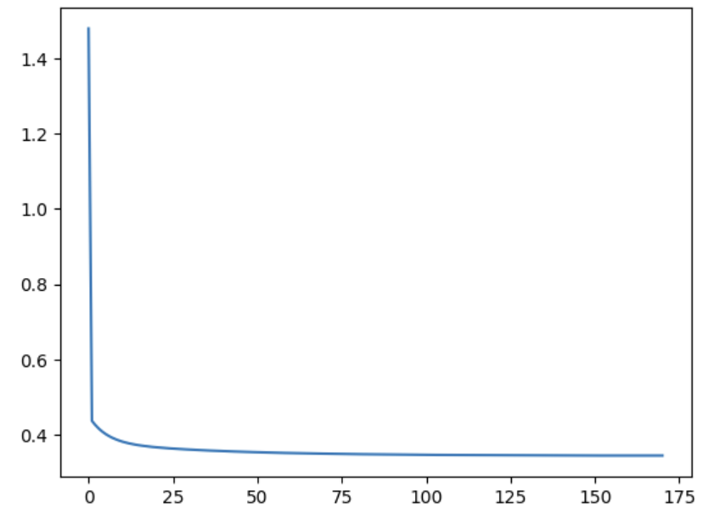
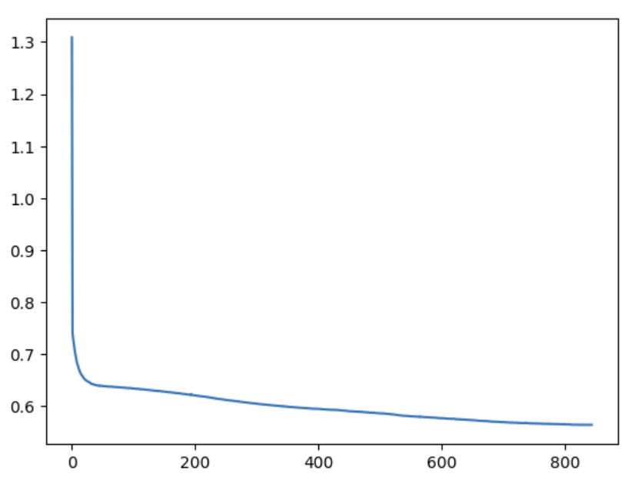
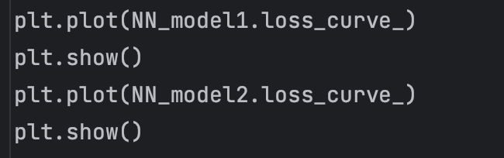
Step 3: Training the NN Model
Model 2: Neural Network Regressor, loss curves
(MedInc, MedHouseVal)
(AveRooms, MedHouseVal)

Slide 20
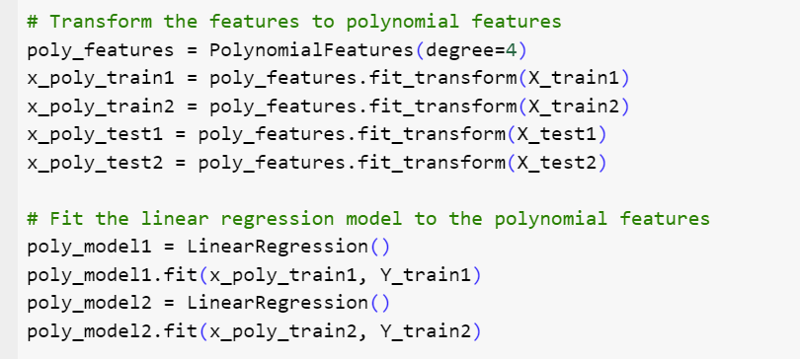
Step 3: Training the Polynomial Model
Model 3: LinearRegression with polynomial features

Slide 21
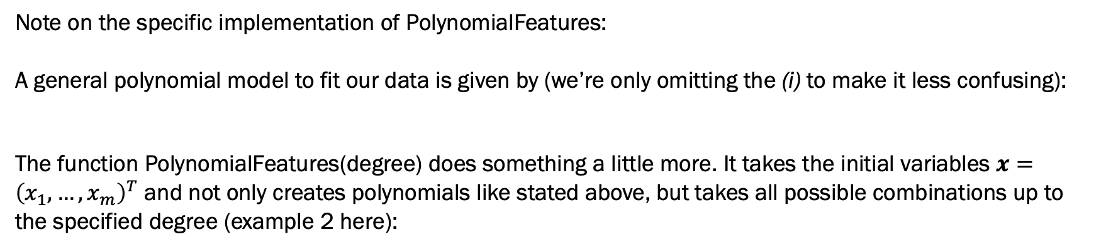
Step 3: Training the Polynomial Model
Note on the specific implementation of PolynomialFeatures:
A general polynomial model to fit our data is given by (we’re only omitting the (i) to make it less confusing):
The function PolynomialFeatures(degree) does something a little more. It takes the initial variables $x={\left(x_{1},…,x_{m}\right)}^{T}$ and not only creates polynomials like stated above, but takes all possible combinations up to the specified degree (example 2 here):
$$f\left(x;θ\right)=θ_{0}+θ_{1}x_{1}^{2}+…+θ_{m}x_{m}^{m}$$
$$x=\left(x_{1},…,x_{m}\right) →{ x}^{′}=\left(1,x_{1},…,x_{m},x_{1}^{2},…,x_{m}^{2},x_{1}x_{2},x_{1}x_{3},…,x_{1}x_{m},x_{2}x_{3},…,x_{2}x_{m},…,\right)$$
Bias (power of 0)
All features to the power of 1
All features raised to a power for each degree
All combinations between all pairs of features

Slide 22
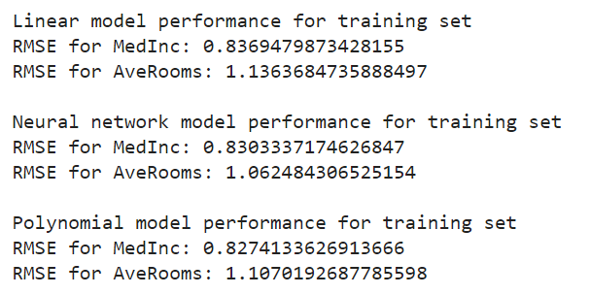
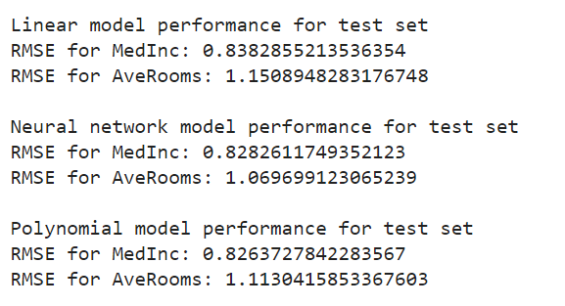
Step 4: Summarize Model Accuracies

Slide 23
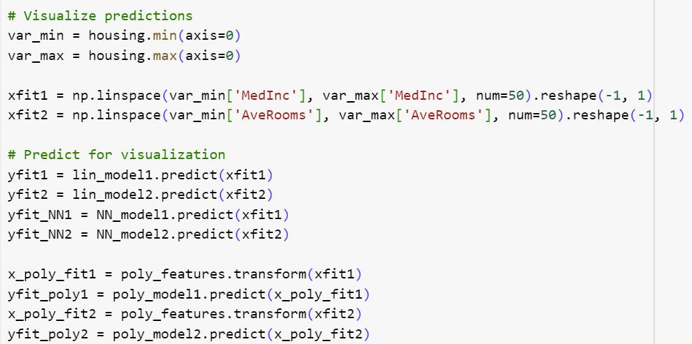
Step 5a: Create fresh data points for prediction

Slide 24
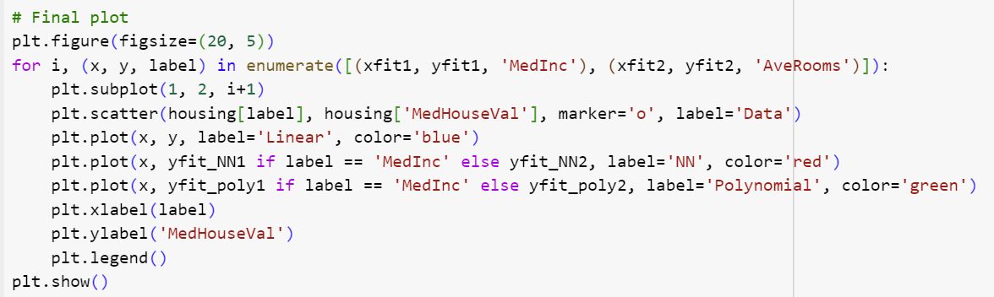
Step 5b: Plot the Results

Slide 25
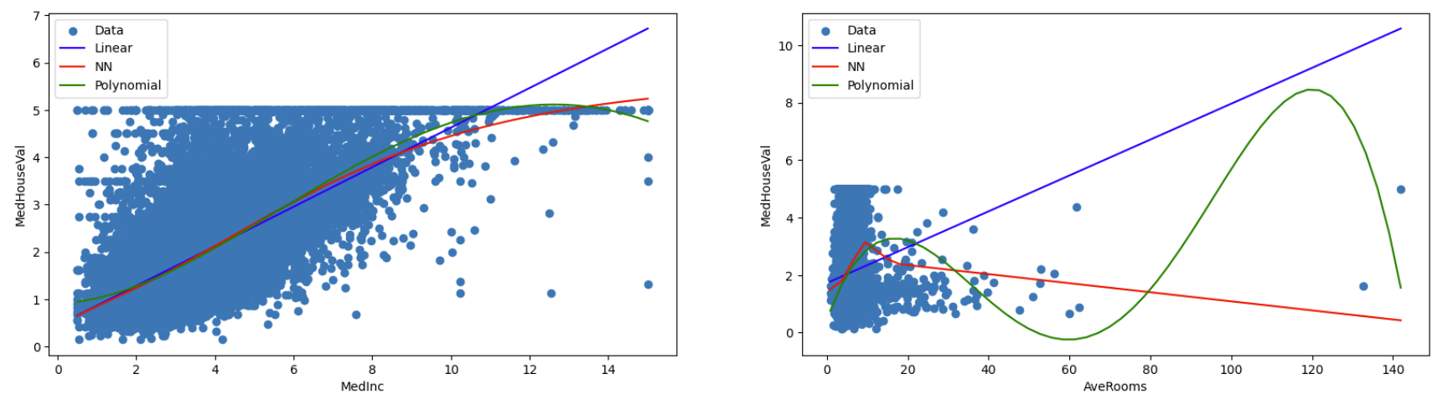
Step 5: Plot the Results

Slide 26
Summary
We introduced MLPRegressor
We recapped the differences between Classification and Regression Problems
We closely examined a Regression problem on the Boston Dataset
We fit 3 models to the data: a linear model, a Neural Network, and a linear regression using polynomial features

